Slide 1
Notes:
Topics:
Sequences
Introduction to Lists
List Slicing
Finding Items in Lists with the in Operator
List Methods and Useful Built-in Functions
Copying Lists
Processing Lists
Two-Dimensional Lists
Tuples
Plotting List Data with the matplotlib Package

Slide 2
Sequences
Sequence: an object that contains multiple items of data
The items are stored in sequence one after another
Python provides different types of sequences, including lists and tuples
The difference between these is that a list is mutable and a tuple is immutable
Notes:
The difference between lists and tuples is simple: a list is mutable, which means that a program can change its contents, but a tuple is immutable, which means that once it is created, its contents cannot be changed.

Slide 3
Introduction to Lists
List: an object that contains multiple data items
Element: An item in a list
Format: list = [item1, item2, etc.]
Can hold items of different types
Examples:
List of integers:
List of strings:
List holding different types:
Notes:
Lists are dynamic data structures, meaning that items may be added to them or removed from them. You can use indexing, slicing, and various methods to work with lists in a program.

Slide 4

Introduction to Lists (cont’d.)
print function can be used to display an entire list
list() function can convert certain types of objects to lists

Slide 5

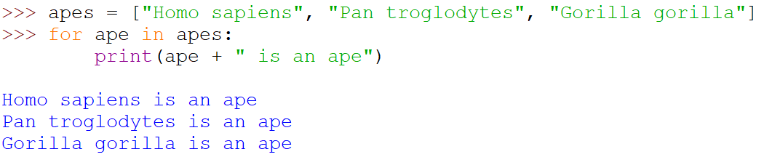
The Repetition Operator and Iterating Over a List
Repetition operator: makes multiple copies of a list and joins them together
The * symbol is a repetition operator when applied to a sequence and an integer
General format: list * n
You can iterate over a list using a for loop
Format: for x in list:
Notes:
Sequence is left operand, number is right

Slide 6
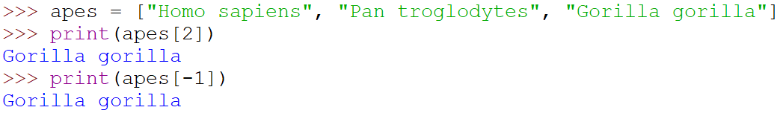
Indexing
Index: a number specifying the position of an element in a list
Enables access to individual element in list
Index of first element in the list is 0
Negative indexes identify positions relative to the end of the list with index -1 identifying the last element

Slide 7
The len function
An IndexError exception is raised if an invalid index is used
len function: returns the length of a sequence such as a list
Example: size = len(my_list)
Returns the number of elements in the list, so the index of last element is len(list)-1
Can be used to prevent an IndexError exception when iterating over a list with a loop

Slide 8
Lists Are Mutable
Mutable sequence: the items in the sequence can be changed
Lists are mutable, and so their elements can be changed
An expression such as
list[1] = new_value
can be used to assign a new value to a list element
Must use a valid index to prevent raising of an IndexError exception
Notes:
1 numbers = [1, 2, 3, 4, 5]
2 print(numbers) # [1, 2, 3, 4, 5]
3 numbers[0] = 99
4 print(numbers) # [99, 2, 3, 4, 5]

Slide 9

Concatenating Lists
Concatenate: join two things together
The + operator can be used to concatenate two lists
Cannot concatenate a list with another data type, such as a number
The += augmented assignment operator can also be used to concatenate lists

Slide 10
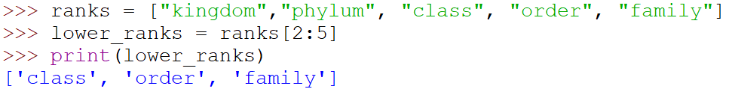
List Slicing
Slice: a span of items that are taken from a sequence
List slicing format: list[start : end]
Span is a list containing copies of elements from start up to, but not including, end
If start not specified, 0 is used for start index
If end not specified, len(list) is used for end index
Slicing expressions can include a step value and negative indexes relative to end of list

Slide 11



Knowledge Check
1. What is the output?
2. What is the output?
3. What is the output?
Notes:
[1, 2, 3, -99, 5]
[1, 3, 5, 7, 9]
[3, 4, 5]

Slide 12
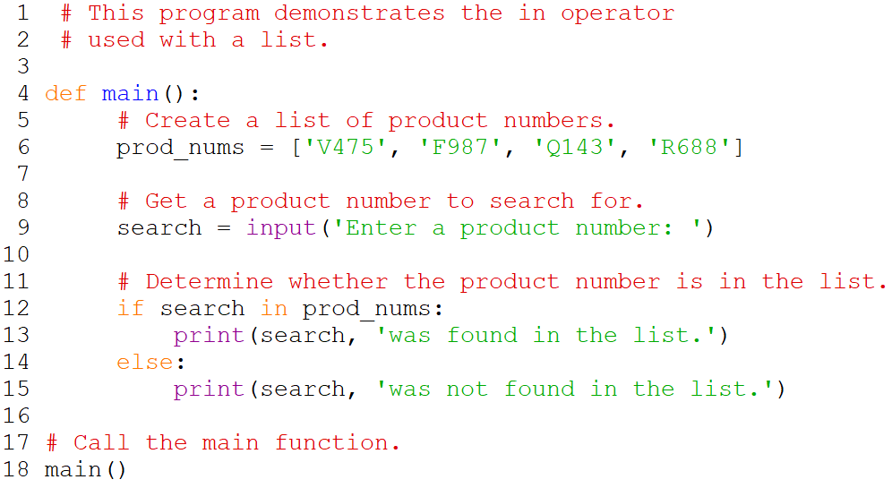
Finding Items in Lists with the in Operator
Use the in operator to determine whether an item is contained in a list
General format: item in list
Returns True if the item is in the list, or False if it is not in the list
Use the not in operator to determine whether an item is not in a list

Slide 13
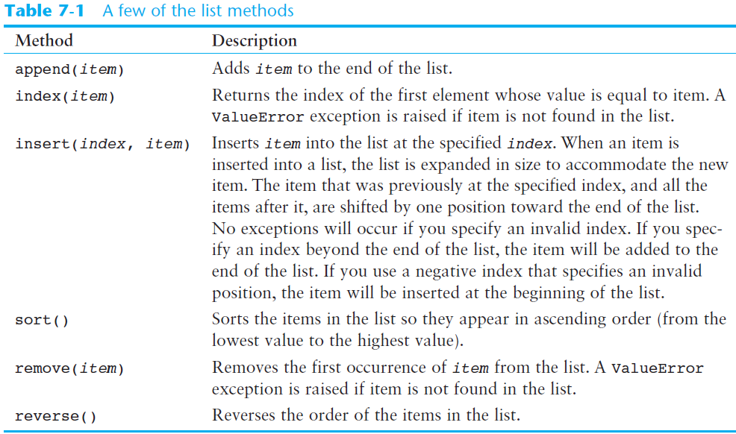
List Methods and Useful Built-in Functions

Slide 14
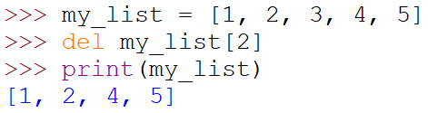
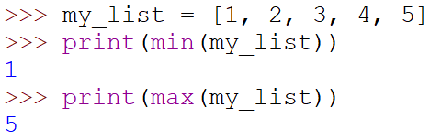
List Methods and Useful Built-in Functions (cont’d.)
del statement: removes an element from a specific index in a list
General format: del list[i]
min and max functions: built-in functions that returns the item that has the lowest or highest value in a sequence
The sequence is passed as an argument

Slide 15
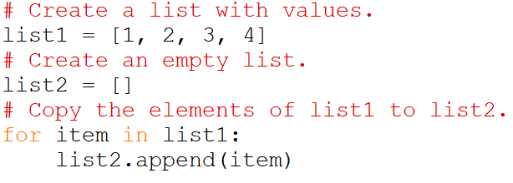
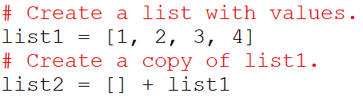
Copying Lists
To make a copy of a list you must copy each element of the list
Two methods to do this:
Creating a new empty list and using a for loop to add a copy of each element from the original list to the new list
Creating a new empty list and concatenating the old list to the new empty list

Slide 16
Processing Lists
List elements can be used in calculations
To calculate total of numeric values in a list use loop with accumulator variable
To average numeric values in a list:
Calculate total of the values
Divide total of the values by len(list)
List can be passed as an argument to a function

Slide 17
Processing Lists (cont’d.)
A function can return a reference to a list
To save the contents of a list to a file:
Use the file object’s writelines method
Does not automatically write \n at then end of each item
Use a for loop to write each element and \n
To read data from a file use the file object’s readlines method

Slide 18
Two-Dimensional Lists
Two-dimensional list: a list that contains other lists as its elements
Also known as nested list
Common to think of two-dimensional lists as having rows and columns
Useful for working with multiple sets of data
To process data in a two-dimensional list need to use two indexes
Typically use nested loops to process

Slide 19
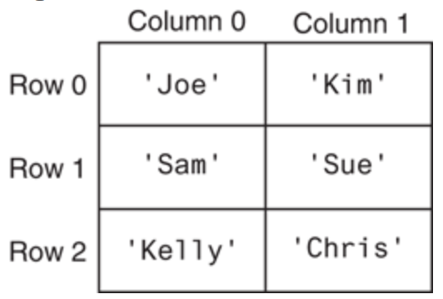
Two-Dimensional Lists (cont’d.)

Slide 20

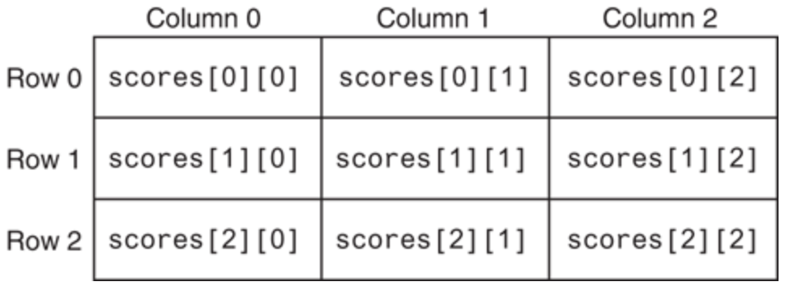
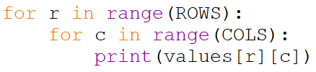
Two-Dimensional Lists (cont’d.)
Use nested loops to loop through all elements:

Slide 21
Tuples
Tuple: an immutable sequence
Very similar to a list
Once it is created it cannot be changed
Format: tuple_name = (item1, item2)
Tuples support operations as lists
Subscript indexing for retrieving elements
Methods such as index
Built in functions such as len, min, max
Slicing expressions
The in, +, and * operators

Slide 22
Tuples (cont’d.)
Tuples do not support the methods:
append
remove
insert
reverse
sort

Slide 23
Tuples (cont’d.)
Advantages for using tuples over lists:
Processing tuples is faster than processing lists
Tuples are safe
Some operations in Python require use of tuples
list() function: converts tuple to list
tuple() function: converts list to tuple
Notes:
If the only difference between lists and tuples is immutability, you might wonder why tuples exist. One reason that tuples exist is performance. Processing a tuple is faster than processing a list, so tuples are good choices when you are processing lots of data, and that data will not be modified. Another reason is that tuples are safe. Because you are not allowed to change the contents of a tuple, you can store data in one and rest assured that it will not be modified (accidentally or otherwise) by any code in your program.

Slide 24
Plotting Data with matplotlib
The matplotlib package is a library for creating two-dimensional charts and graphs.
To install matplotlib on a Windows system, open a Command Prompt window and enter this command:
To install matplotlib on a Mac or Linux system, open a Terminal window and enter this command:
See Appendix F in your textbook for more information about packages and the pip utility.
pip install matplotlib
sudo pip3 install matplotlib
Notes:
It is not part of the standard Python library, so you will have to install it separately, after you have installed Python on your system.

Slide 25
Plotting Data with matplotlib
To verify the package was installed, start IDLE and enter this command: If you don't see any error messages, you can assume the package was properly installed.
The matplotlib package contains a module named pyplot that you will need to import.
Use the following import statement to import the module and create an alias named plt:
>>> import matplotlib
import matplotlib.pyplot as plt

Slide 26
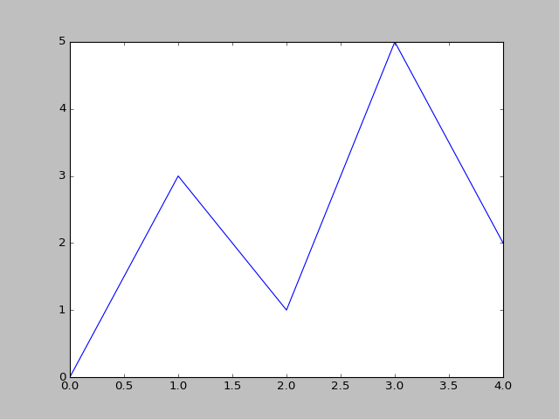
Plotting a Line Graph with the plot Function
Use the plot function to create a line graph that connects a series of points with straight lines.
The line graph has a horizontal X axis, and a vertical Y axis.
Each point in the graph is located at a (X,Y) coordinate.

Slide 27
Plotting a Line Graph with the plot Function
Program 7-19 (line_graph1.py)
1 # This program displays a simple line graph.
2 import matplotlib.pyplot as plt
3
4 def main():
5 # Create lists with the X and Y coordinates of each data point.
6 x_coords = [0, 1, 2, 3, 4]
7 y_coords = [0, 3, 1, 5, 2]
8
9 # Build the line graph.
10 plt.plot(x_coords, y_coords)
11
12 # Display the line graph.
13 plt.show()
14
15 # Call the main function.
16 main()

Slide 28
Plotting a Line Graph with the plot Function
You can change the lower and upper limits of the X and Y axes by calling the xlim and ylim functions. Example:
This code does the following:
Causes the X axis to begin at 1 and end at 100
Causes the Y axis to begin at 10 and end at 50
plt.xlim(xmin=1, xmax=100)
plt.ylim(ymin=10, ymax=50)

Slide 29
Plotting a Line Graph with the plot Function
You can customize each tick mark's label with the xticks and yticks functions.
These functions each take two lists as arguments.
The first argument is a list of tick mark locations
The second argument is a list of labels to display at the specified locations.
plt.xticks([0, 1, 2, 3, 4],
['2016', '2017', '2018', '2019', '2020'])
plt.yticks([0, 1, 2, 3, 4, 5],
['$0m', '$1m', '$2m', '$3m', '$4m', '$5m'])

Slide 30
Program 7-24
1 # This program displays a simple line graph. 2 import matplotlib.pyplot as plt 3 4 def main(): 5 # Create lists with the X,Y coordinates of each data point. 6 x_coords = [0, 1, 2, 3, 4] 7 y_coords = [0, 3, 1, 5, 2] 8 9 # Build the line graph. 10 plt.plot(x_coords, y_coords, marker='o') 11 12 # Add a title. 13 plt.title('Sales by Year') 14 15 # Add labels to the axes. 16 plt.xlabel('Year') 17 plt.ylabel('Sales') 18
Continued…

Slide 31
Program 7-24 (continued)
19 # Customize the tick marks. 20 plt.xticks([0, 1, 2, 3, 4], 21 ['2016', '2017', '2018', '2019', '2020']) 22 plt.yticks([0, 1, 2, 3, 4, 5], 23 ['$0m', '$1m', '$2m', '$3m', '$4m', '$5m']) 24 25 # Add a grid. 26 plt.grid(True) 27 28 # Display the line graph. 29 plt.show() 30 31 # Call the main function. 32 main()

Slide 32
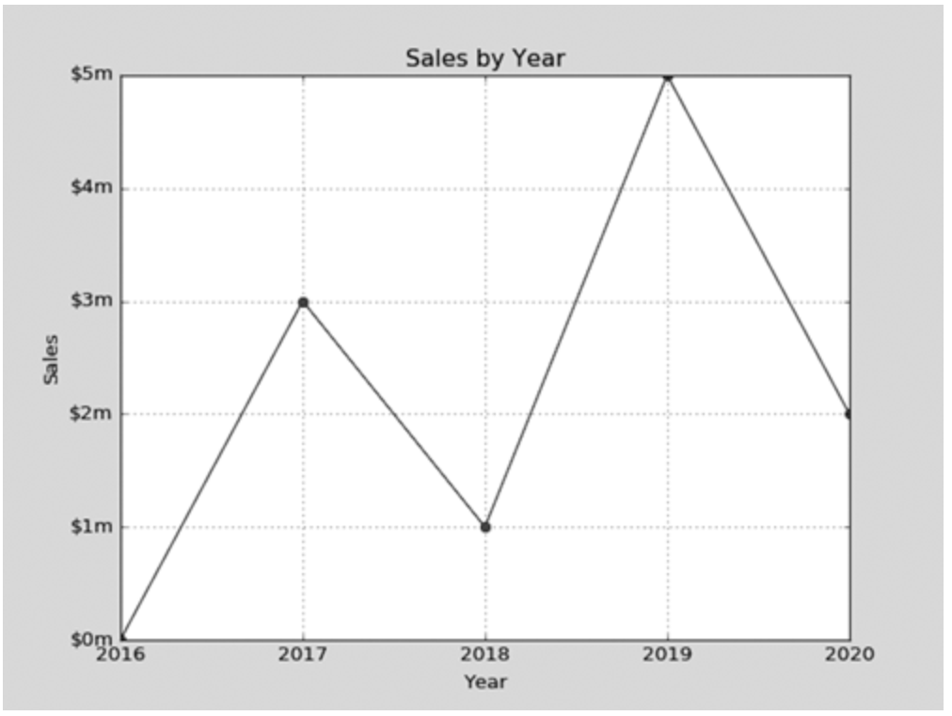
Output of Program 7-24
Displayed by the yticks() function.
Displayed by the title() function.
Displayed by the ylabel() function.
Displayed by the xticks() function.
Displayed by the xlabel() function.

Slide 33
Plotting a Bar Chart
Use the bar function in the matplotlib.pyplot module to create a bar chart.
The function needs two lists: one with the X coordinates of each bar's left edge, and another with the heights of each bar, along the Y axis.

Slide 34
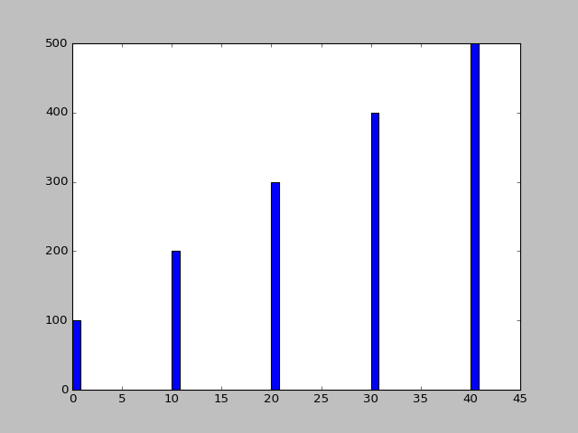
Plotting a Bar Chart
left_edges = [0, 10, 20, 30, 40]
heights = [100, 200, 300, 400, 500]
plt.bar(left_edges, heights)
plt.show()

Slide 35
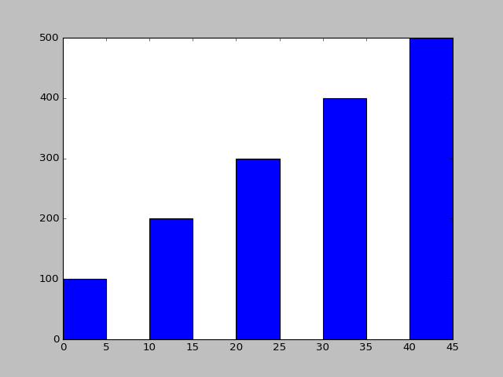
Plotting a Bar Chart
The default width of each bar in a bar graph is 0.8 along the X axis.
You can change the bar width by passing a third argument to the bar function.
left_edges = [0, 10, 20, 30, 40]
heights = [100, 200, 300, 400, 500]
bar_width = 5
plt.bar(left_edges, heights, bar_width)
plt.show()

Slide 36
Plotting a Bar Chart
The bar function has a color parameter that you can use to change the colors of the bars.
The argument that you pass into this parameter is a tuple containing a series of color codes.
Color Code | Corresponding Color
'b' | Blue
'g' | Green
'r' | Red
'c' | Cyan
'm' | Magenta
'y' | Yellow
'k' | Black
'w' | White

Slide 37
Plotting a Bar Chart
Example of how to pass a tuple of color codes as a keyword argument:
The colors of the bars in the resulting bar chart will be as follows:
The first bar will be red.
The second bar will be green.
The third bar will be blue.
The fourth bar will be white.
The fifth bar will be black.
plt.bar(left_edges, heights, color=('r', 'g', 'b', 'w', 'k'))

Slide 38
Plotting a Bar Chart
Use the xlabel and ylabel functions to add labels to the X and Y axes.
Use the xticks function to display custom tick mark labels along the X axis
Use the yticks function to display custom tick mark labels along the Y axis.

Slide 39
Plotting a Pie Chart
You use the pie function in the matplotlib.pyplot module to create a pie chart.
When you call the pie function, you pass a list of values as an argument.
The sum of the values will be used as the value of the whole.
Each element in the list will become a slice in the pie chart.
The size of a slice represents that element's value as a percentage of the whole.

Slide 40
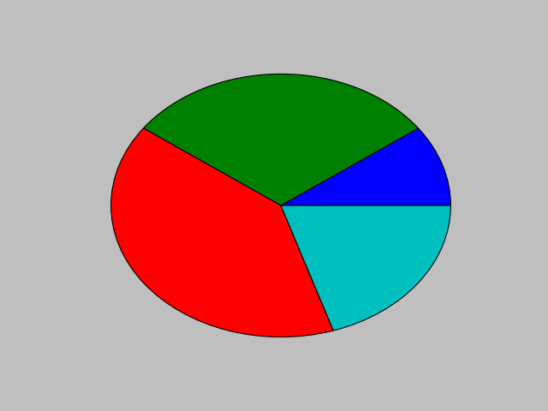
Plotting a Pie Chart
Example:
values = [20, 60, 80, 40]
plt.pie(values)
plt.show()

Slide 41
Plotting a Pie Chart
The pie function has a labels parameter that you can use to display labels for the slices in the pie chart.
The argument that you pass into this parameter is a list containing the desired labels, as strings.

Slide 42
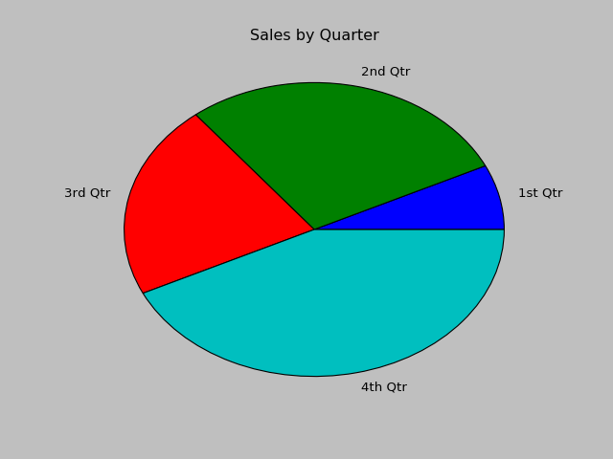
Plotting a Pie Chart
Example:
sales = [100, 400, 300, 600]
slice_labels = ['1st Qtr', '2nd Qtr', '3rd Qtr', '4th Qtr']
plt.pie(sales, labels=slice_labels)
plt.title('Sales by Quarter')
plt.show()

Slide 43
Plotting a Pie Chart
The pie function automatically changes the color of the slices, in the following order:
blue, green, red, cyan, magenta, yellow, black, and white
You can specify a different set of colors, however, by passing a tuple of color codes as an argument to the pie function's colors parameter:
When this statement executes, the colors of the slices in the resulting pie chart will be red, green, blue, white, and black.
plt.pie(values, colors=('r', 'g', 'b', 'w', 'k'))

Slide 44
Summary
This chapter covered:
Lists, including:
Repetition and concatenation operators
Indexing
Techniques for processing lists
Slicing and copying lists
List methods and built-in functions for lists
Two-dimensional lists
Tuples, including:
Immutability
Difference from and advantages over lists
Plotting charts and graphs with the matplotlib Package

